Slide 1
Week 6 – Lab B Data Hiding

Slide 2


Outline
Data Hiding
Getters and setters

Slide 3
Motivation
Since starting Programming 2, most of the classes we have created in Eclipse (or the IDE you have chosen), have been public, and the attributes and methods of those classes have also typically been public
This session will look at why this may not be an ideal approach, and how we can go about controlling access to our objects
Data Hiding
Getters and Setters

Slide 4
Data Hiding
An object should hide its internal data (variables) from code that is outside the class that the object is an instance of
We can achieve this by making such variables private
Declaring instance variables as private is known as data hiding or information hiding
Data Hiding is an important concept in object-oriented programming – we will see why shortly
Only the class’s methods should directly access and make changes to the object’s internal data
Why would we want to make variables private?
Data Hiding
Getters and Setters

Slide 5
Motivation
public class Player { public String name; public int hitPoints; public String weapon; Player(String name, int hitPoints, String weapon) { this.name = name; this.hitPoints = hitPoints; this.weapon = weapon; } public void takeDamage(int damage) { hitPoints = hitPoints - damage; if( hitPoints <= 0 ) { System.out.println("Player knocked out"); } } }
Let’s take a look at an example where everything is public
Simple Player class
3 variables
1 method
Data Hiding
Getters and Setters

Slide 6
Motivation
Player
name : String hitPoints : int weapon : String
takeDamage( damage : int ) : void
public class Main {
public static void main(String[] args) {
Player me = new Player("Lewis", 30, "Baseball bat"); // name, hitPoints, weapon
me.takeDamage(18);
System.out.println(me.hitPoints); // Lewis' hitpoints is now 12
me.takeDamage(15);
System.out.println(me.hitPoints); // Lewis' hitpoints is now -3
me.hitPoints = 40000;
}
}
Should we really allow code from outside the Player class to modify its data to non-sensible values?
Data Hiding
Getters and Setters

Slide 7
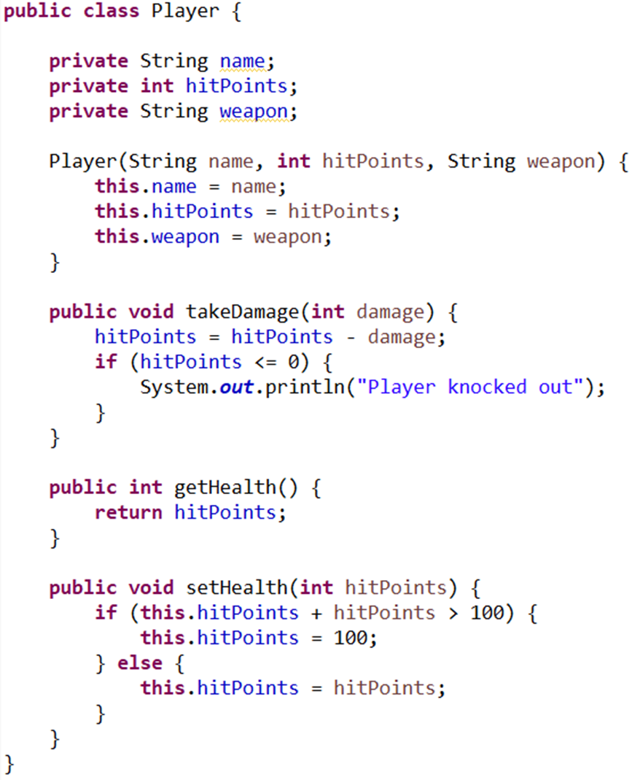
Improved Version
Instance variables are now private – meaning only the class can directly access them
Indirect access is allowed through public methods
We provide a means for code outside the class to retrieve the private hitPoints variable via the public getHealth method
setHealth method scrutinises the input to ensure the hitPoints does not exceed 100 (similar check could also be done in constructor to prevent a Player object being created with > 100 hitPoints)
Data Hiding
Getters and Setters

Slide 8
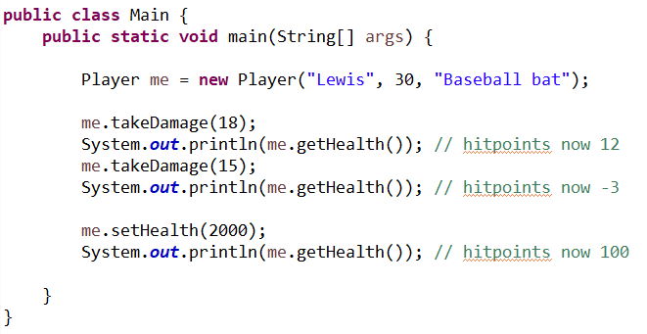
Improved Version
Although code from outside the Player class can still indirectly modify hitPoints, it must do so through the setHealth method, which scrutinises the input
Data Hiding
Getters and Setters

Slide 9
What’s the point?
At this point you may still be wondering – what exactly is the point in doing this? Why can’t we just make everything public?
As you are learning to program, you are the user of your programs, so it might seem like you’re putting a lot of effort into hiding data from yourself
If you write software in industry, however, the classes you create will be used as components in a larger system, and programmers other than yourself will be using your classes
By hiding a class’s internal workings, and allowing it to be accessed only through the class’s public methods, you can better ensure that the class will operate as you intended it to
Data Hiding
Getters and Setters

Slide 10

Getters and setters
Data Hiding
Getters and Setters

Slide 11
Getters and Setters
When hiding the internals of a class (e.g. variables) through the use of access modifiers (e.g. private), we’ve seen how we can still allow users indirect access to those variables by providing public methods
Methods that change a variable are often referred to as mutator methods or setter methods (setters for short)
setHealth, setName, setWeapon
Methods that retrieve a variable are referred to as accessor methods or getter methods (getters for short)
getHealth, getName, getWeapon
Known colloquially as ‘getters and setters’
Data Hiding
Getters and Setters

Slide 12
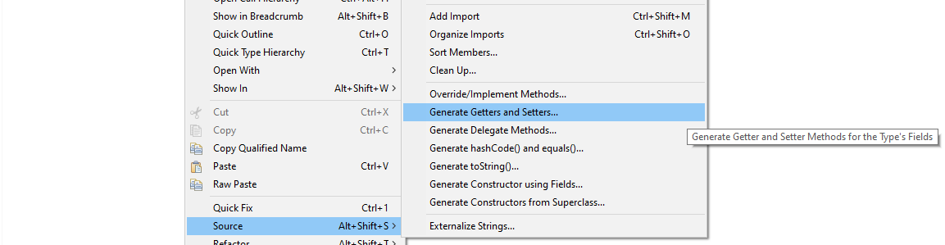
Getters and Setters
Since providing getters and setters for variables of a class is so common, many IDEs include ways to quickly generate them:
Eclipse: Right-click inside class code window -> Source -> Generate Getters and Setters
Data Hiding
Getters and Setters

Slide 13
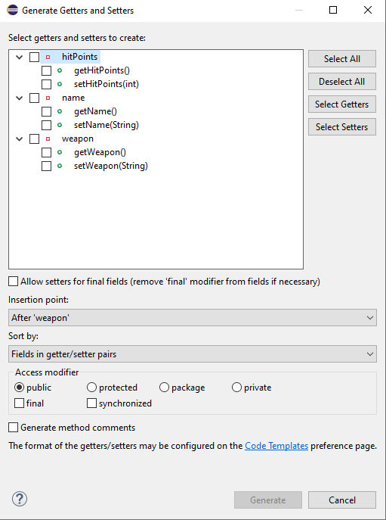
Getters and Setters
Can choose which variables to provide getters and setters for, and choose where they should be inserted in the code
Data Hiding
Getters and Setters

Slide 14

Summary
Data hiding refers to the hiding of the internals of a class through the use of access modifiers
We have compared the public and private access modifiers – there is a third – protected – that relates to inheritance (and also a fourth if you include the default access permission – see next slide for an overview)
Getters and setters – allow access to data in a controlled way
Part B of this lab:
Work through the Part B exercises
Or
Show your assessment to your lab tutor for formative feedback. Note: your tutor cannot mark your assessment in the timetabled session – it must be submitted online

Slide 15
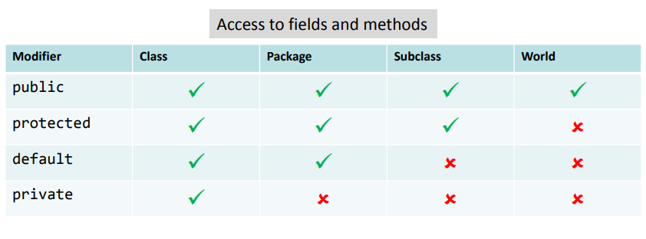
Summary

